Slide 1
7.4 wks
Phase 1 Here
9.8 wks
Phase 2 Here
13.4 wks
Phase 3 Here
21.4 wks
Phase 4 Here
34.6 wks
Phase 5 Here
34.6 wks
Phase 6 Here
26 wks
Phase 7 Here
18 wks
Phase 8 Here
6.4 wks
Phase 9 Here
13.2 wks
Phase 10 Here
Week 1
9
17
25
33
41
49
57
65
73
81
May 30
Jan 1
Target 1
Target 3
Oct 1
Jul 1
Oct 15
Target 2
Target 4
Target 5

Slide 2
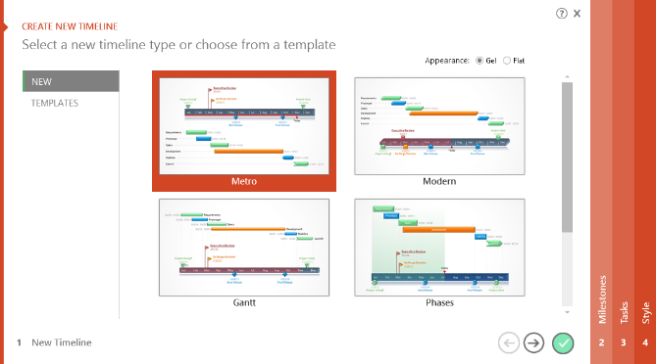
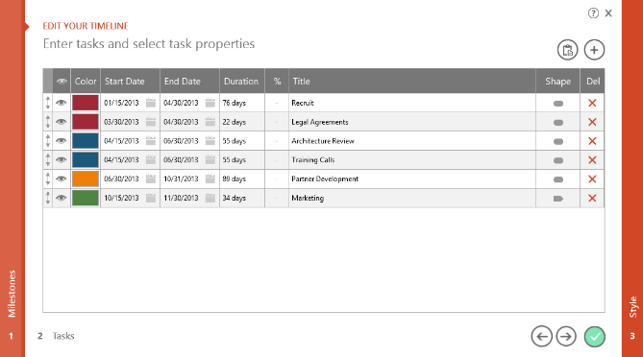
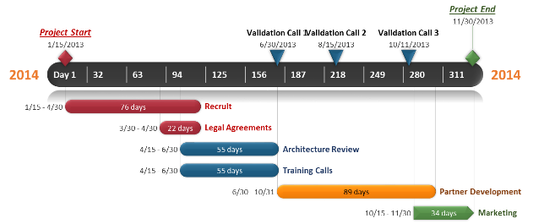
To change and update this template automatically,
download the free Office Timeline PowerPoint add-in!
Office Timeline is a free, award winning, timeline maker that's really easy to use.
Simple, easy-to-use wizards.
Professional, quick results.
Built directly into PowerPoint

