Slide 1

Marketing Plan
Target Market
North America
2013
Jun
Jul
Aug
Sep
Oct
Nov
Dec
Jan
2014
2014
Situational Analysis
6/1/13 - 7/28/13
Objectives
7/28/13 - 8/25/13
Strategy Creation
8/20/13 - 9/30/13
Tactics
9/8/13 - 10/8/13
Action Plan
10/8/13 - 11/15/13
Control Mechanism
11/15/13 - 1/8/14

Slide 2

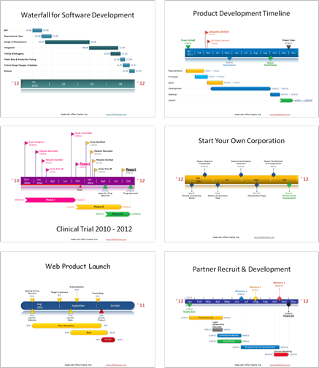
Award winning, free, timeline maker
for Microsoft PowerPoint™
Simple, easy to use wizard.
Professional, quick results.
Built directly into PowerPoint!
What are professionals saying about
Office Timeline Plus?
“
“I love this! I’ve been creating all these graphics manually for months and just wanted to smack myself upside the head when I saw this.”
“I can’t believe I’ve been using VISIO all these years! I've been missing out.”
“I like it because it's simple, intuitive and looks great! I used it with a client who likes the product and has changed how she represents her project schedules.”
Copyright © 2012, Office Timeline, LLC. All rights reserved.

Slide 3

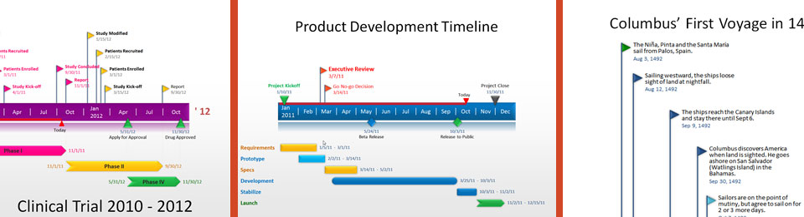

Promotion Code: FPPT2012
GET 15% OFF!
Receive a 15% discount on your purchase of Office Timeline Plus edition when you use promotion code “FPPT2012”.
Learn More
www.fppt.com/officetimeline
Copyright © 2012, Office Timeline, LLC. All rights reserved.

